Slide 1
Wrath Assignment 1 ICT290 Semester 2 2020
Group Team No Name 2
Connor Nicholson, Vladislav Kennebury, Charlie Sewell

Slide 2
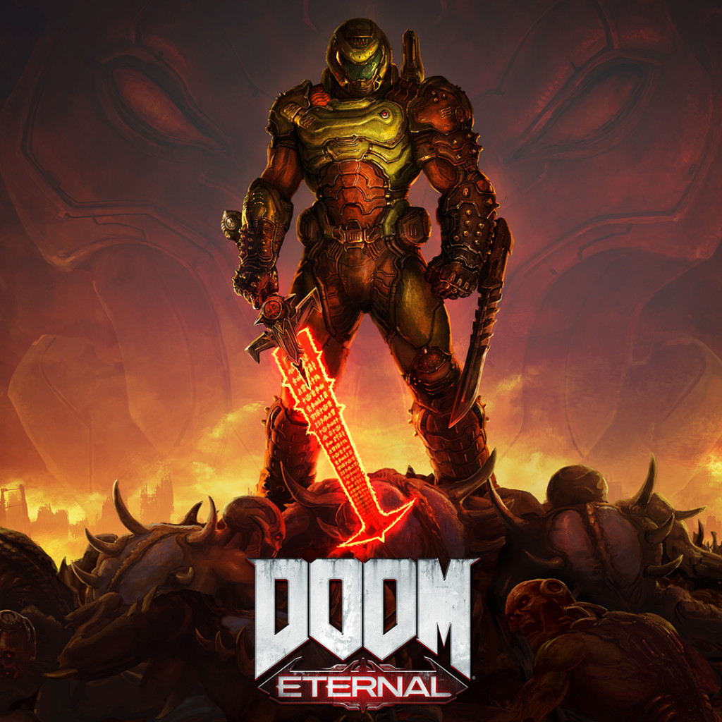
Introduction to Game
Inspirations included FPS games such as Doom and Halo. With the intention of the player being the one hunting down rogue AI’s.
Sci-fi features such as portals and an environment in outer space were conceptualised, with further plans to expand on this theme.
Planned on being semi-linear game with a final boss.

Slide 3
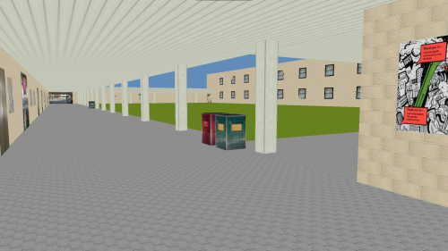
Bush Court Extension

Slide 4

What special features in your game?
Camera - Camera is implemented to control the same as a typical FPS camera, which will be familiar to those who have played similar games in the genre.
Portals - Allows seamless transition in to various locations around both Shay’s and the game world.
Change of display - Controls the textures rendered depending on the world the player is currently in. Altered with a boolean in main.

Slide 5
Issues
Camera - Getting the camera to control correctly was a challenge to get the trigonometric math correct, while trying to make it work with Shay’s pre-existing systems.
Textures - Mapping of textures on various axis's presented tedious challenges with trying to figure out solution which could be used in similar scenarios in the future.
Collision - Plain creation, especially in regards to stairs caused a few issues in regards to clipping through certain spaces.
Portal - Detection of the player varied from individual and needed to be accounted for with the layout.

Slide 6
Complete tasks breakdown
Connor: FPS camera, Initial modelling of extension, display switch and initial modeling of new world.
Vlad: Stairs modelling/texturing/collision, portal implementation, arranged/re-oriented courtyard textures, courtyard object collision.
Charlie: Implemented PNG loader, Doxygen, git ignore and merge conflict resolutions.

Slide 7
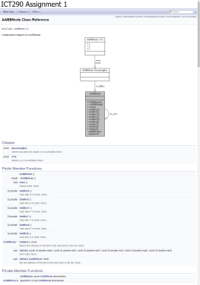
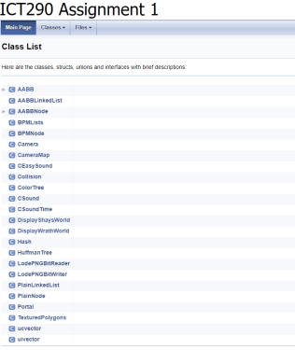
External documentation

Slide 8
Plans for Assignment 2
We plan to progress our world into a ‘Doom style’ first person shooter.
We plan to incorporate portals into the level design to enhance the player experience.
The enemies will be AI controlled, implemented as a finite state system to control basic steering behaviours.
The shooting will be implemented using hit-scan technique.

Slide 9
Q&A
Thanks for listening!
Any questions?

